Slide 1



Elements Profiles
elements.lshtm.ac.uk

Slide 2
Elements
Elements is the School’s Research Information System. It allows you to produce Public web profiles, and CVs tailored to School review and promotions procedures.
To produce an up-to-date Profile or CV, you need to:
Add/update employment and education details
Add or Claim missing publications
Add yourself to Grants where you are a named Co-Investigator
Add/update professional activities such as Honours, Prizes, Learned Society, Journal and Funding Body roles
Check your Discovery Profile on profiles.lshtm.ac.uk and lshtm.ac.uk/people
Generate the CV, check the automated output of the above, make any corrections in Elements
Generate final CV draft
fill in the manual sections

Slide 3
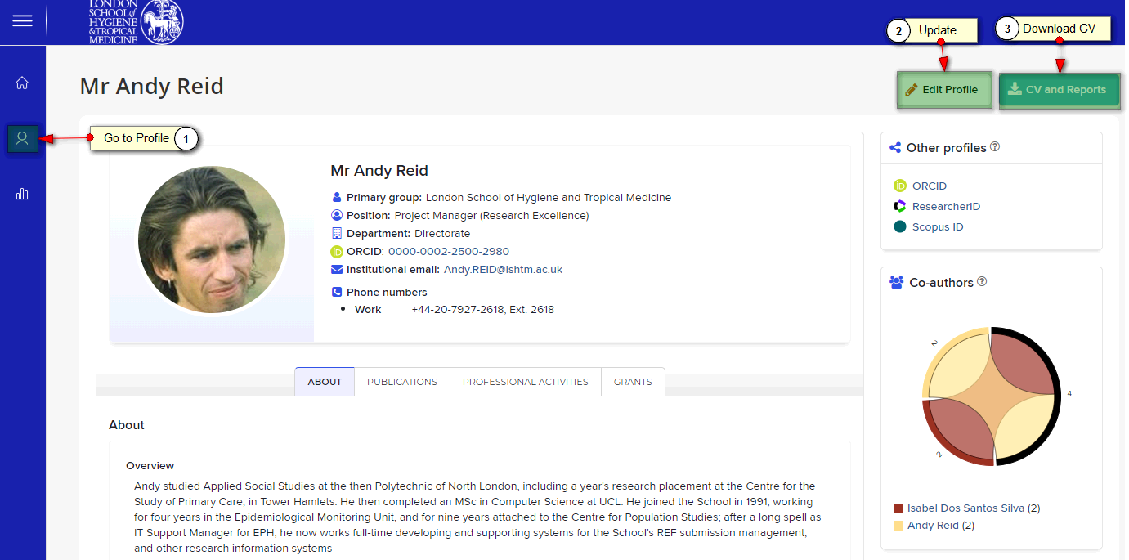
Elements Internal Profile
Your Elements Profile contains some of the details that make up the CV template and web profiles:
Education, Experience, Degrees, Certifications and Post-Graduate Training. It is only visible to other logged in Elements users
Elements also feeds Publications, Professional Activities and Grants into the CV and public profiles

Slide 4
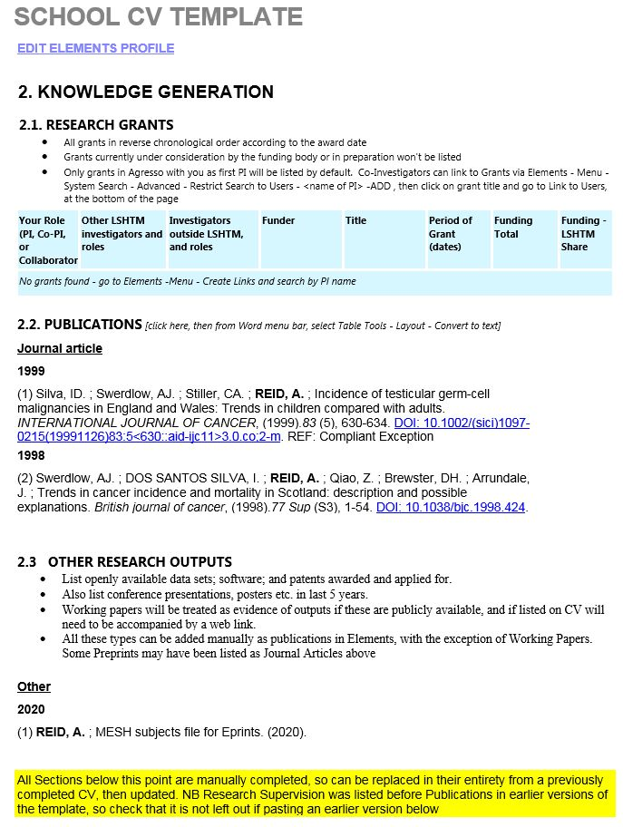
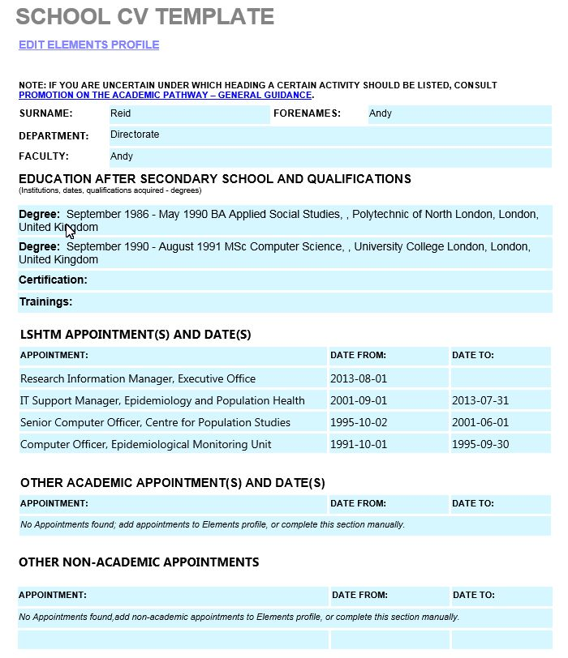
Elements CV Template
Elements will generate a Word document conforming to the School CV template, and pre-loaded with data from Elements, plus blank sections to be completed manually

Slide 5
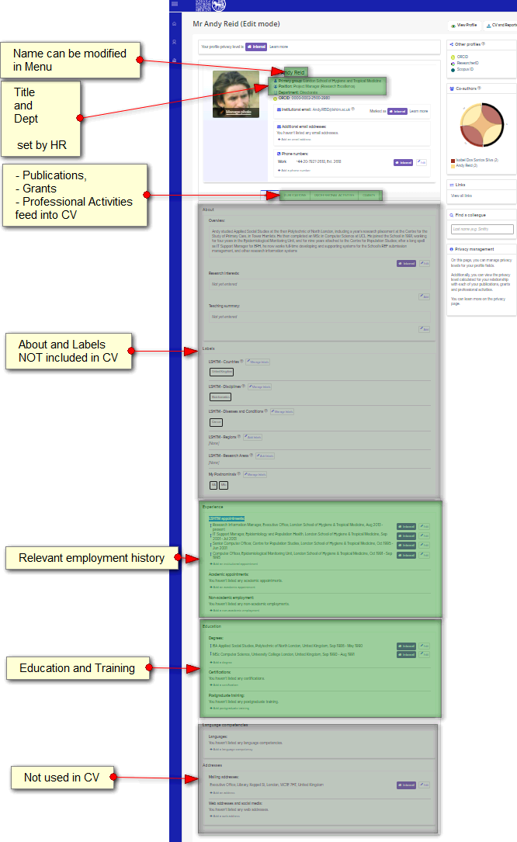
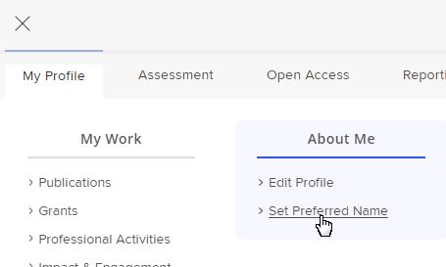


Edit Profile for CV
Your Profile contains some of the details that make up the CV template:
Name can be modified via Menu – About Me - Set Preferred Name
Title and Dept are drawn from HR/Registry records – contact them for corrections
Education, Experience, Degrees, Certifications and Post-Graduate Training
Enter in Elements – Edit Profile
Elements also feeds Publications, Professional Activities and Grants into the CV (See Menu – My Profile – My Work for details)

Slide 6
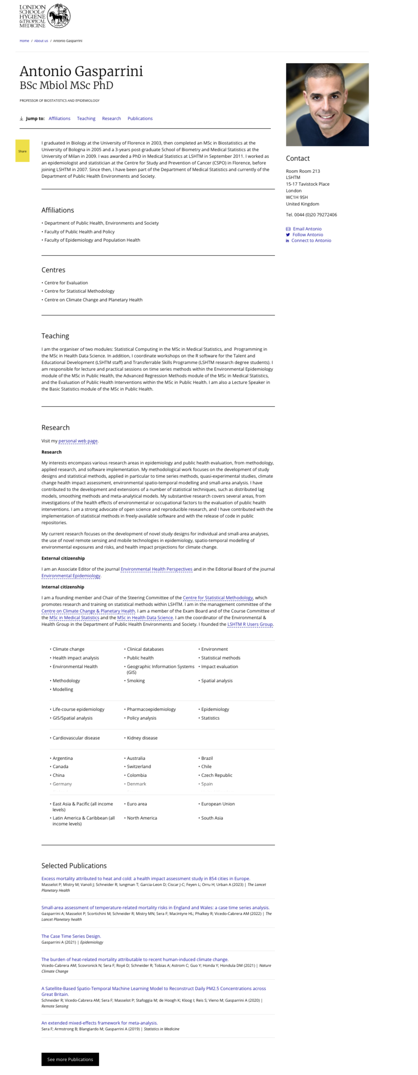
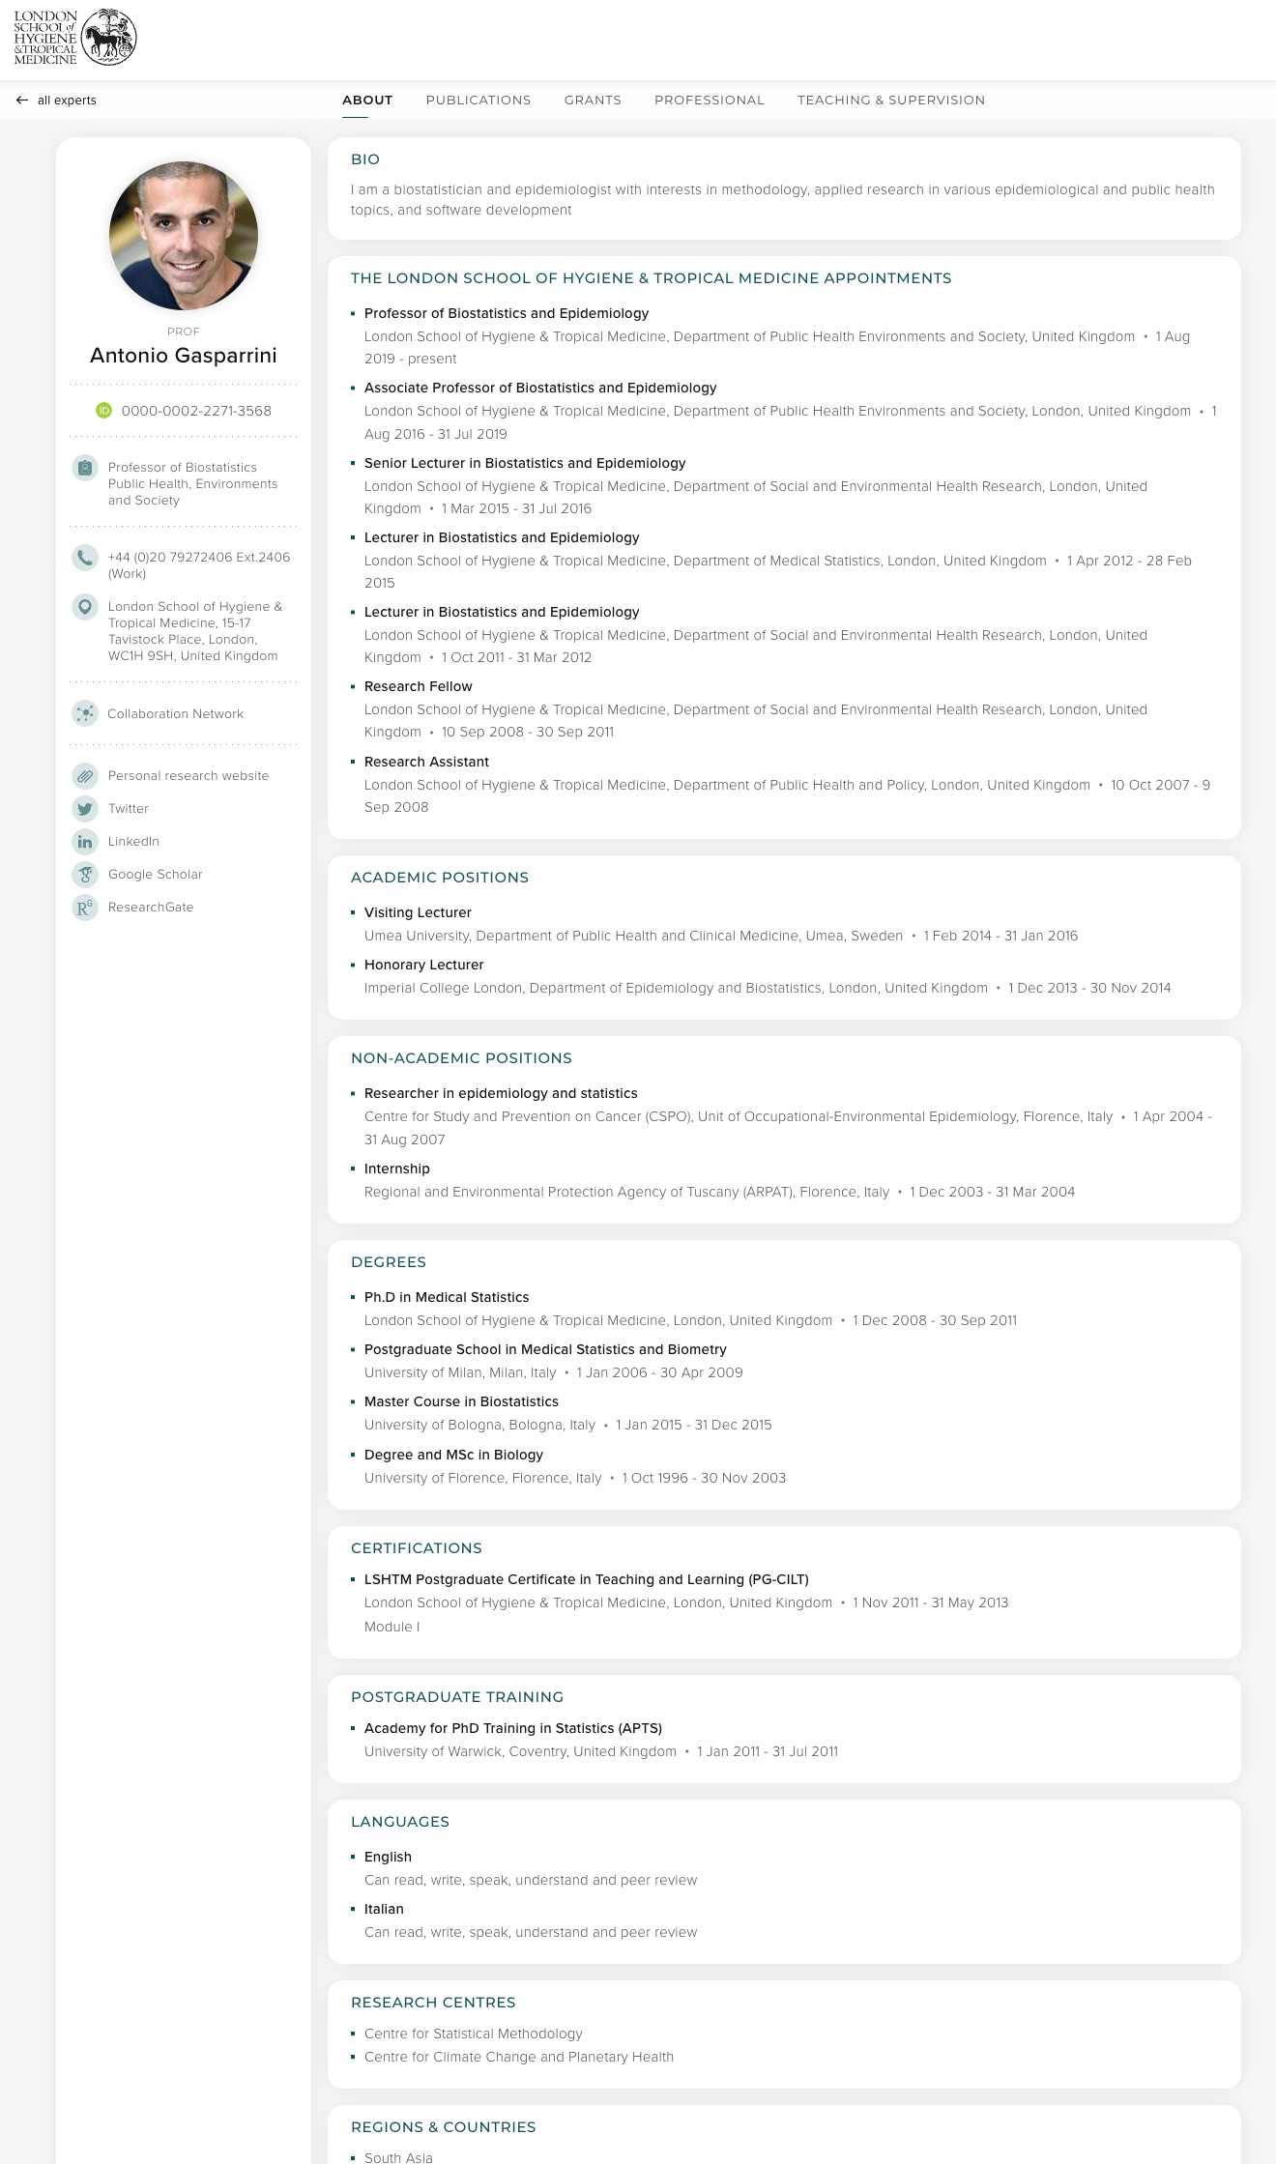
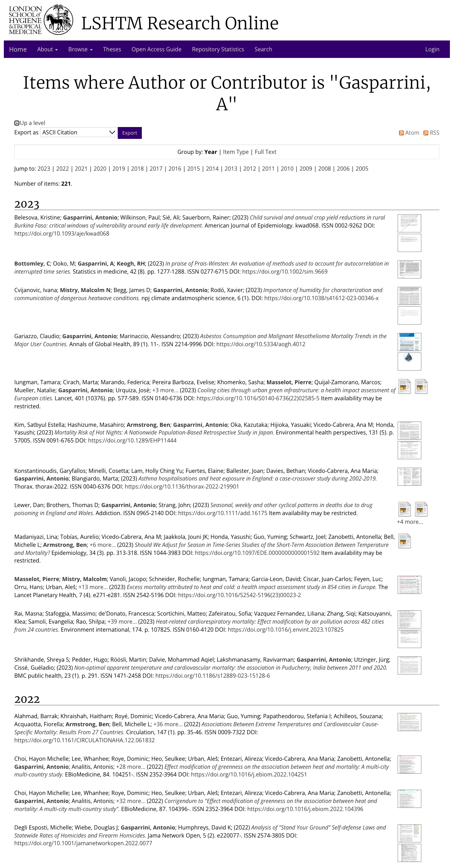
Public Profiles
Gateway Profile
Discovery Profile
LSHTM Research Online
Note: only items deposited as full-text will appear in this listing,
post-2018

Slide 7
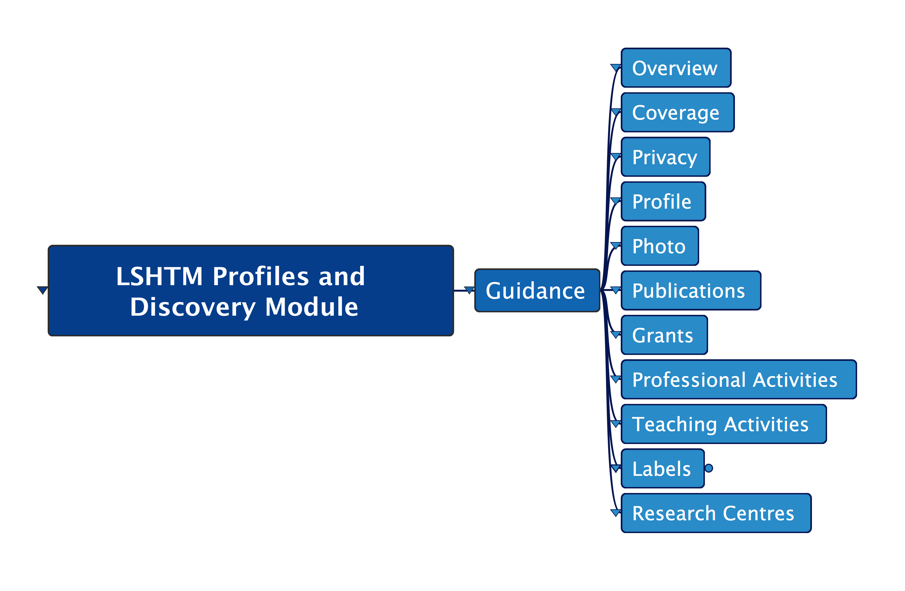

Slide 8
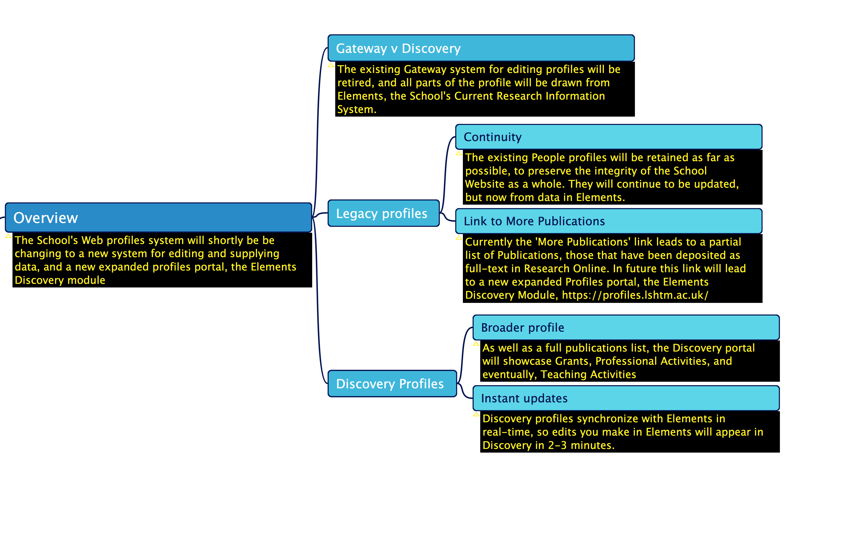

Slide 9
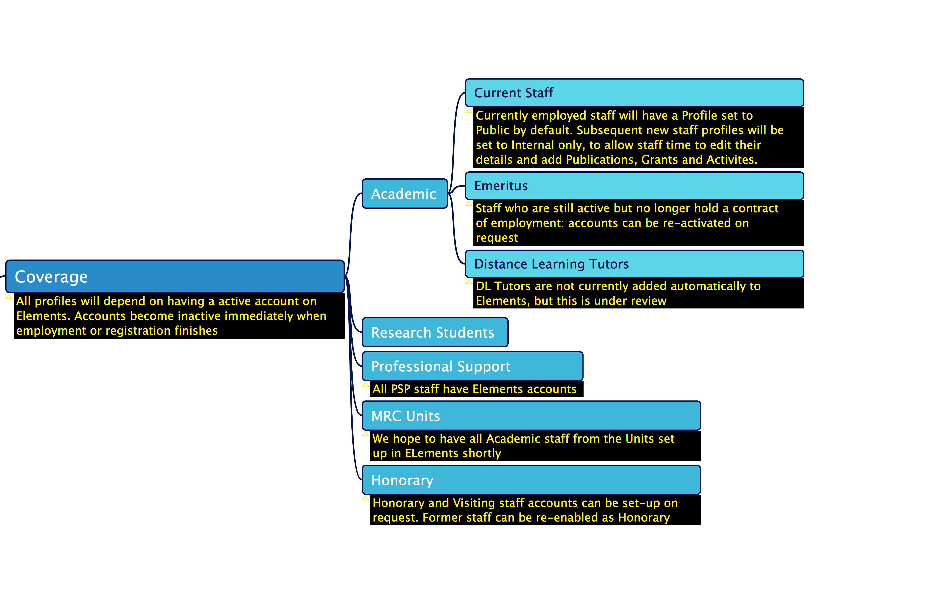

Slide 10
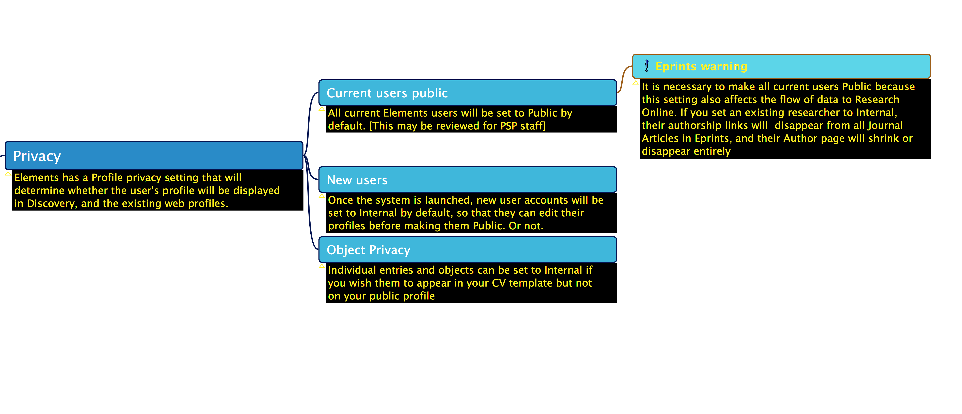

Slide 11
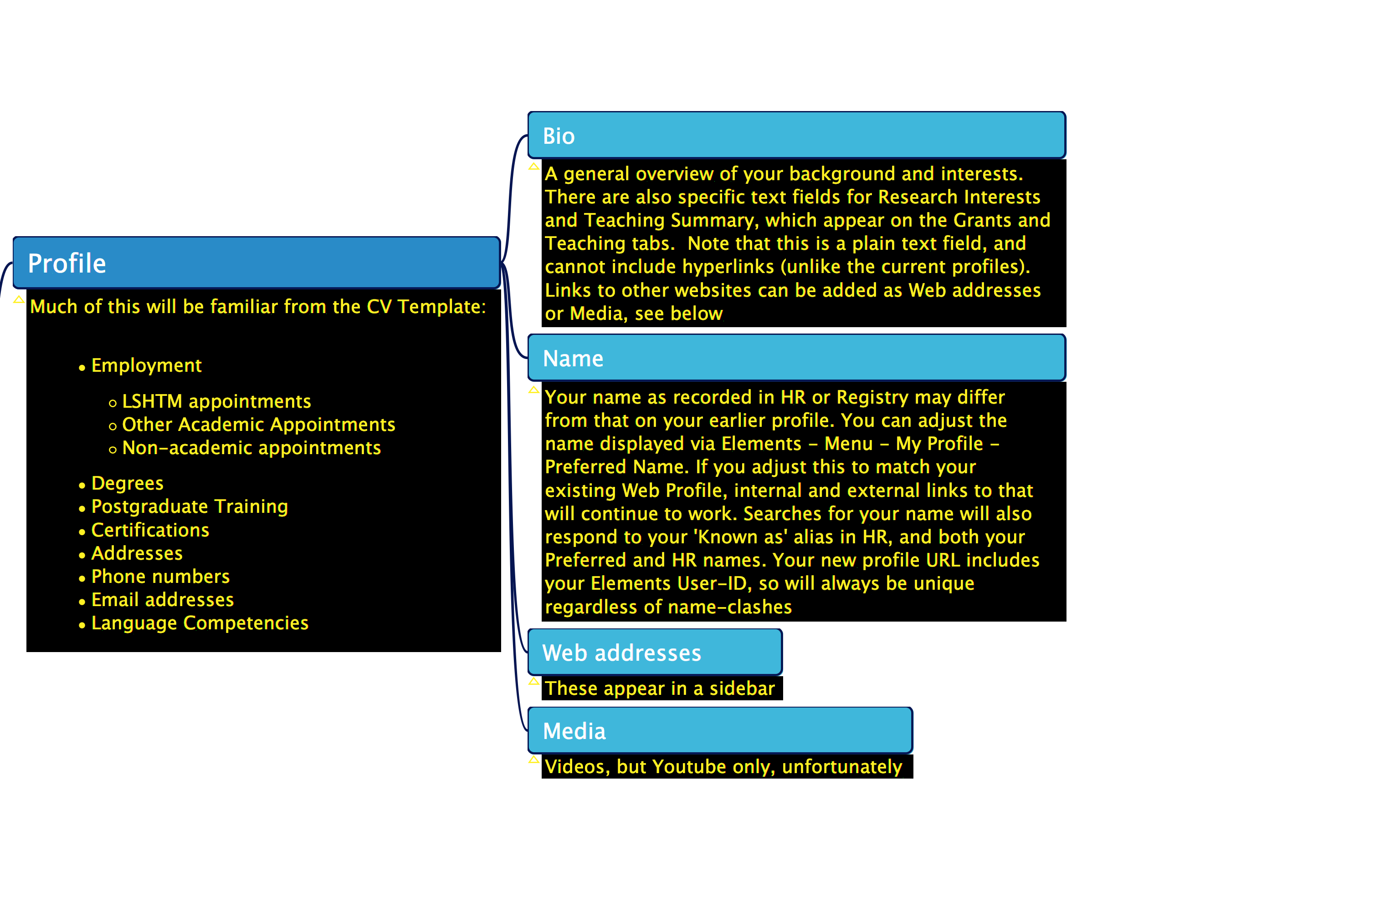

Slide 12
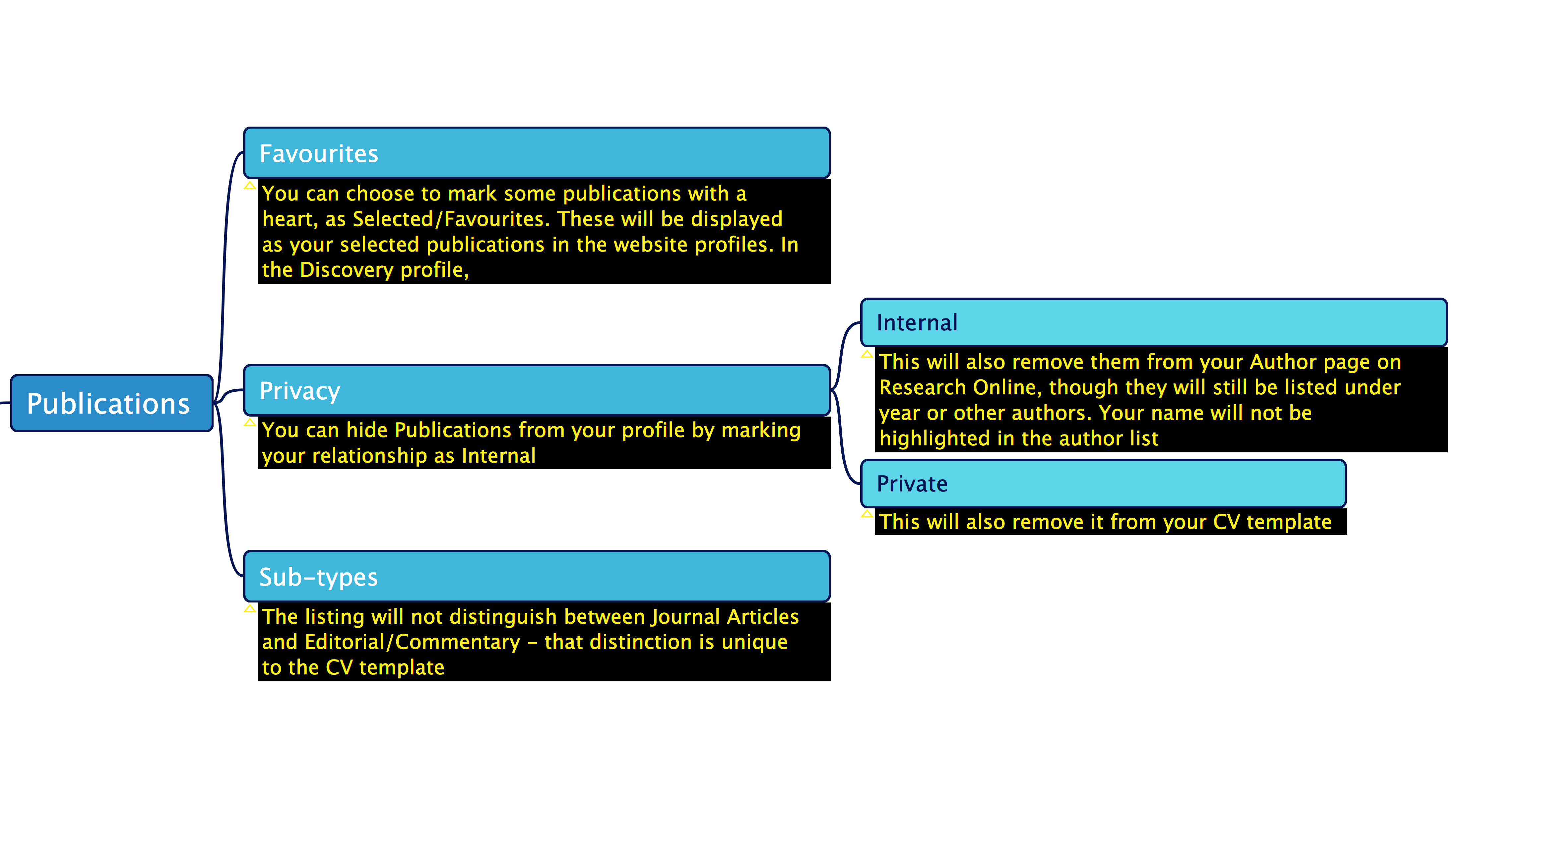

Slide 13
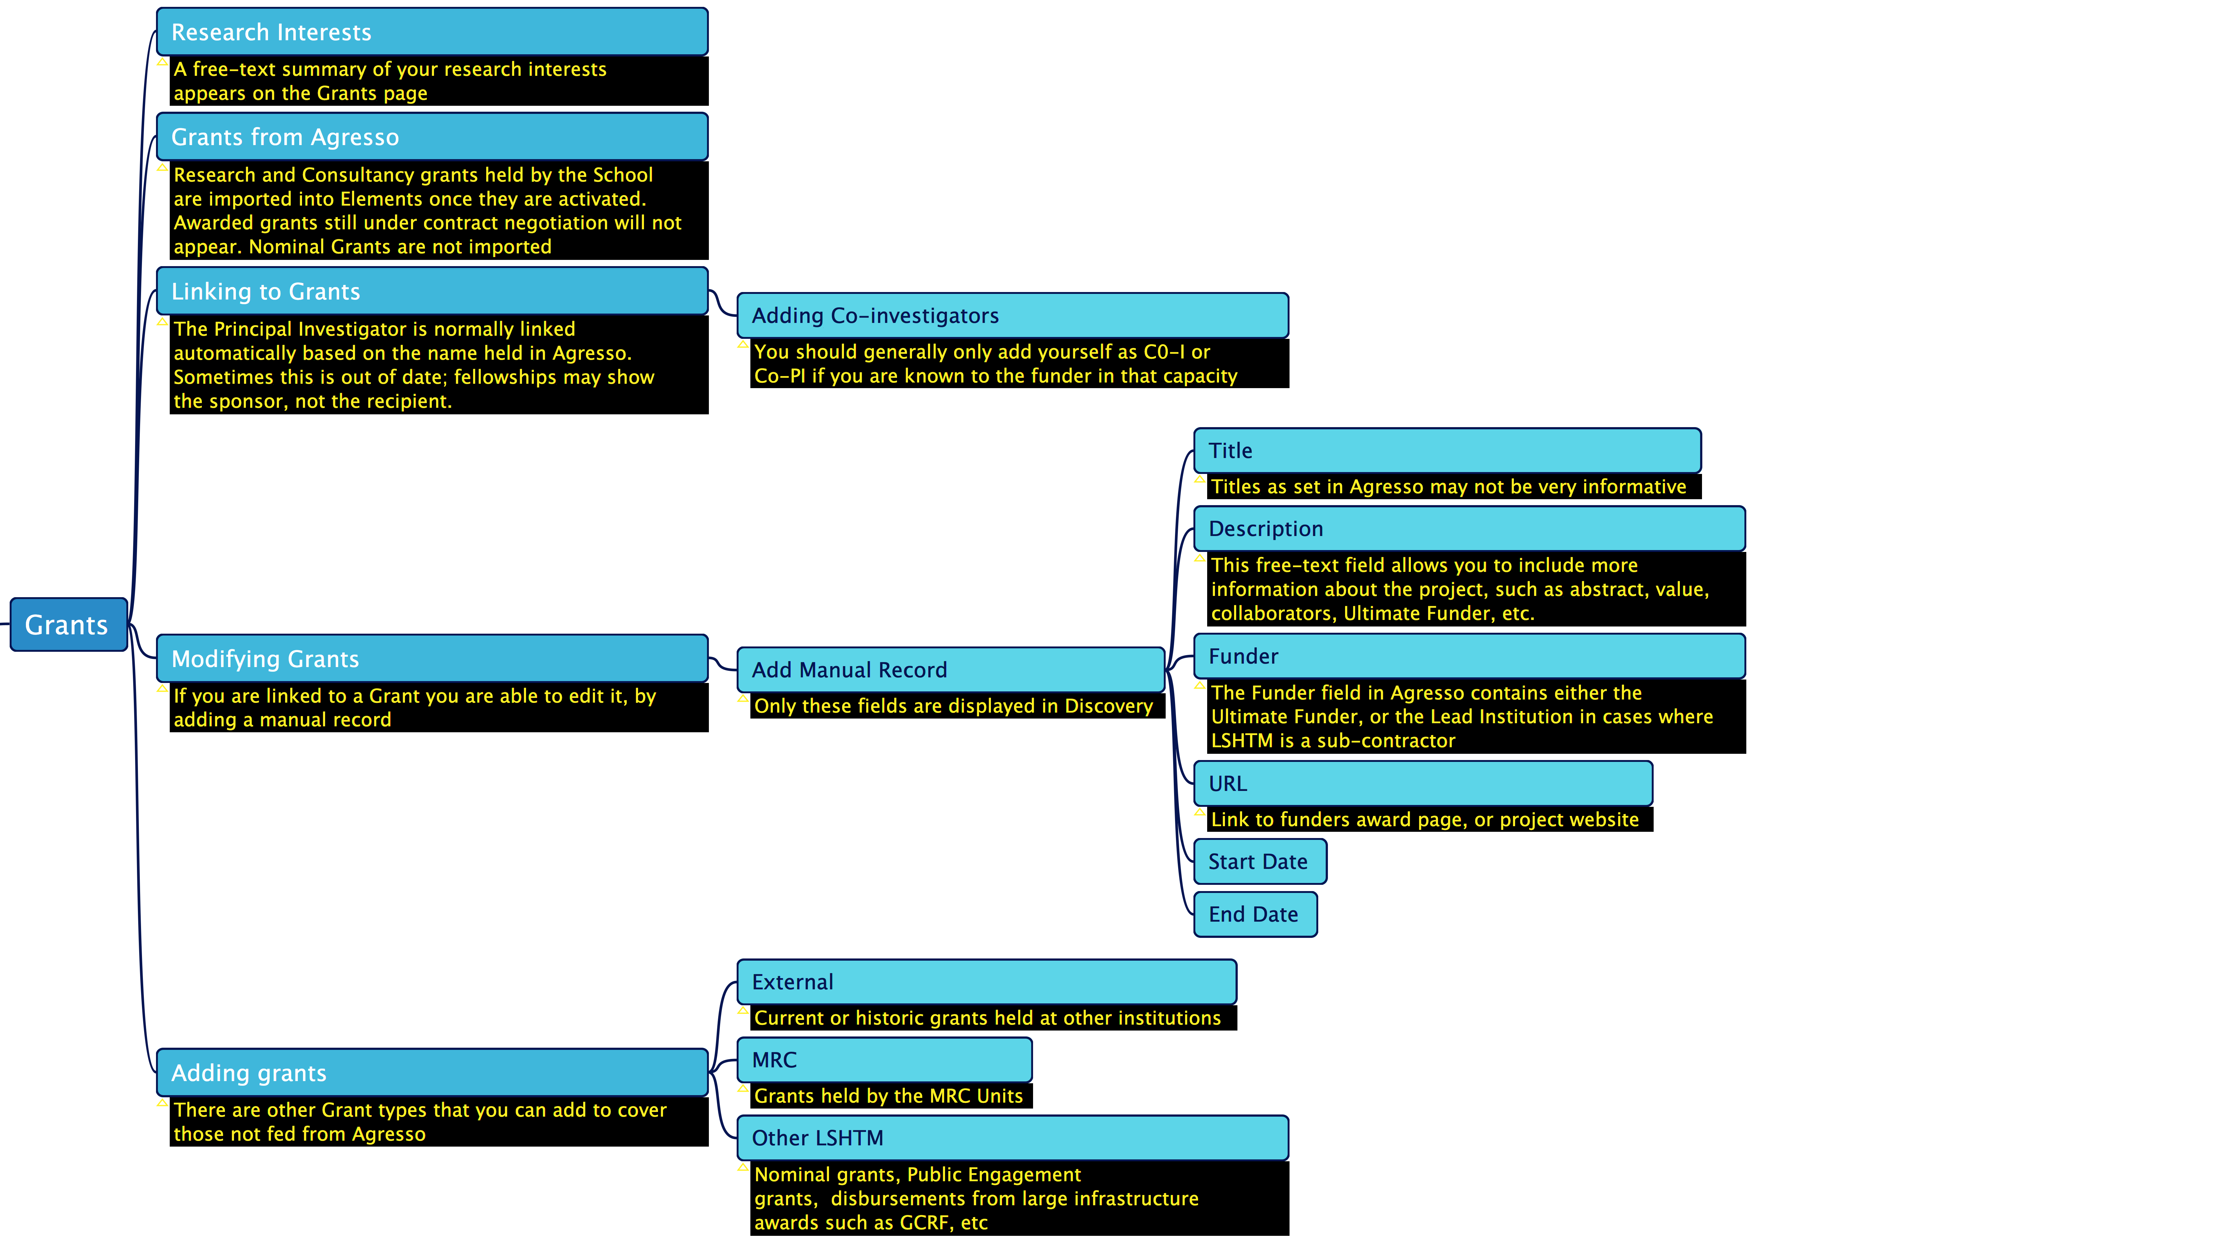

Slide 14
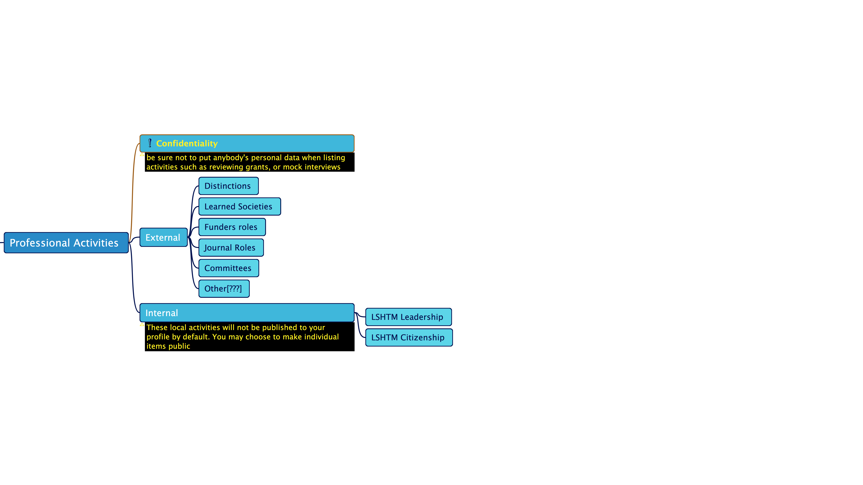
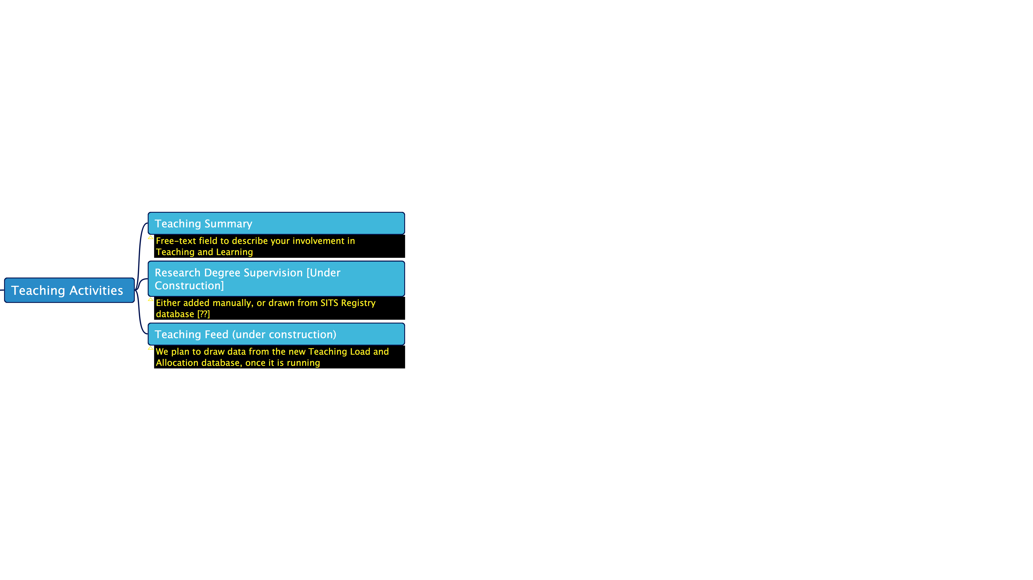

Slide 15
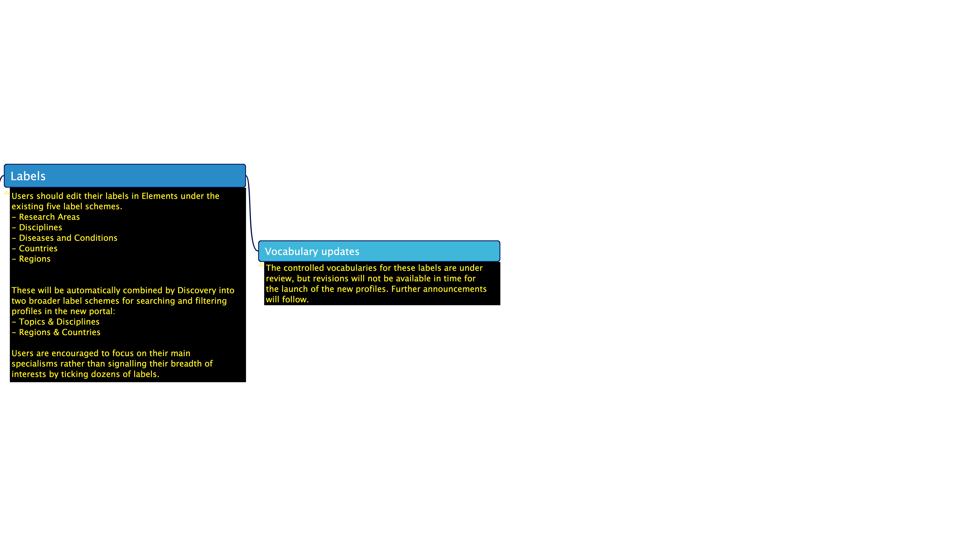


Slide 16
Help
Further material is available via the Help Page.
Further help can be sought via ServiceDesk .
Library, Archive & Open Research Services
Elements(CRIS)

